Slide 1
General Viva Presentation
CCE-4832

Slide 2
Group-04
Submitted By:
E193009 Zia Ul Hassan Chowdhury
Submitted To:
Engr. Md. Razu Ahmed
Professor & Chairman Department Of CCE IIUC

Slide 3
Course: Basic Electronics
CCE-1203

Slide 4
Contents
Semiconductor
P-N Junction
Applications of diode
Bipolar Junction transistor
Field Effect Transistor
Transistor Biasing

Slide 5
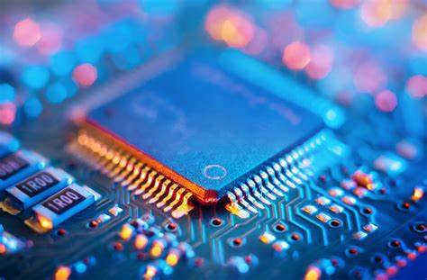
Semiconductor

Slide 6
1. What is a semiconductor?
A semiconductor is a material with electrical conductivity between a conductor and an insulator. Semiconductors are typically made from silicon or germanium.
2. Some useful Properties of semiconductors.
Semiconductors have high electron mobility.
Semiconductors have a relatively low electrical conductivity compared to conductors like copper and gold, but higher than insulators like glass and rubber.
Semiconductors are sensitive to light and heat
3. Which are the most commonly used semiconductors and why?
The most commonly used semiconductors are silicon and germanium. These materials are used primarily because they have a high electron mobility, which means that they allow electrical current to flow through them easily.

Slide 7
4. The energy band description of semiconductors.
The energy band description of semiconductors is that they have a partially filled valence band and an empty conduction band. The valence band is the uppermost band that is filled with electrons and is responsible for chemical bonding in the material. The conduction band is the band just above the valence band that is mostly empty and is responsible for electrical conductivity. The bandgap, or energy gap, is the separation between these two bands
5. What is Doping?
The process of adding impurities to semiconductors is called doping. Doping can be done by introducing impurities such as boron, phosphorus, or arsenic into the semiconductor material.
6. Effect of temperature on semiconductors.
The effect of temperature on semiconductors is complex and depends on the specific material and application. In general, as the temperature of a semiconductor increases, its electrical conductivity also increases.

Slide 8
7. What is a hole in a semiconductor?
A hole in a semiconductor is a region where there is a lack of an electron, resulting in a positive charge.
8. What do you understand by intrinsic and extrinsic semiconductors?
Intrinsic semiconductors are semiconductors in their pure, undoped form. They are made of a single element, such as silicon or germanium, and have an equal number of electrons and holes in the material.
Extrinsic semiconductors are semiconductors that have been doped or had impurities added to them.
9. What is PN Junction?
A p-n junction is a type of semiconductor device formed by combining p-type and n-type semiconductor materials, creating a junction where electrical charges can flow. This is the basic building block of diodes, transistors, and other electronic devices.

Slide 9
10. The behavior of a p-n junction under forward and reverse biasing.
In forward biasing, a positive voltage is applied to the p-type side of the junction, and a negative voltage is applied to the n-type side, reducing the built-in potential and allowing for current flow. In reverse biasing, a negative voltage is applied to the p-type side and a positive voltage is applied to the n-type side, increasing the built-in potential and inhibiting current flow.
11. Write short notes on the following:
(i) Breakdown voltage
(ii) Knee voltage
(iii) Limitations in the operating conditions of p-n junction
(i) Breakdown voltage: It is the voltage at which the p-n junction suddenly allows a large increase in current, leading to damage or destruction of the device.
(ii) Knee voltage: It is the voltage at which the current flow through the pn junction starts to increase rapidly.
(iii) Limitations in operating conditions of p-n junction: The p-n junction has limitations in its operating temperature range, high reverse voltage, and high forward current, which can lead to thermal breakdown and device degradation. The junction also has a limited frequency response, making it unsuitable for high-speed applications.

Slide 10
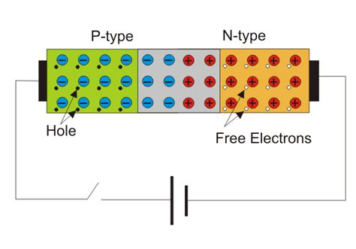
P-N Junction

Slide 11
12. What Are P-N Junctions?
A p-n junction is an interface between p-type and n-type semiconductor materials within a single semiconductor crystal.
13. How P-N Junctions Work?
P-N junctions are what you get when you combine a p-type semiconductor and an n-type semiconductor, back to back, in a single crystal, with no boundaries between them.
It might seem simple, but some surprising things happen as a result. Let’s take a look at a p-n junction to learn how they work.
The p-side contains a plethora of free holes and the n-side contains free electrons. Both sides are electrically neutral, as the charged atoms (ions) on either side balance out the charge of the free electrons and holes.
On the p-side of the junction, negatively charged ions balance the charge of the free (positively charged) holes. On the n-side, positively charged ions balance the charge of the free (negatively charged) electrons.

Slide 12
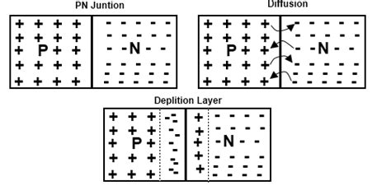
14. What is the formation of depletion layer in diode?
Formation of Depletion Layer in Diode. There is greater concentration of holes in P-region and electrons in N-region. This difference in concentration establishes a density mismatch across the junction resulting in majority carrier diffusion Holes diffuse from P to N and electrons from N to P regions causing the recombination.
Fig: depletion layer formation

Slide 13
15. What is PIV rating in a diode?
PIV stands for ‘Peak Inverse Voltage’. It refers to the maximum reverse bias voltage a semiconductor diode or other semiconductor devices can withstand without damaging themselves. The peak inverse voltage is also known as peak reverse voltage.
PIV rating of a diode is temperature-dependent. It increases with an increase in temperature and decreases with a decrease in temperature. Peak Inverse voltage rating is determined by the manufacturer. A typical diode used in rectifiers has a PIV rating of at least 50Vdc at room temperature. However, diodes with high peak inverse voltage ratings of thousands of volts are also available in the market.

Slide 14
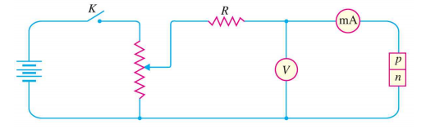
16. Describe V-I Characteristics of PN Junction Diode?
Volt-ampere (V-I) characteristics of a p-n junction or semiconductor diode is the curve between voltage across the junction and the current through the circuit. Normally the voltage is taken along the x-axis and current along y-axis.
The circuit connection for determining the V-I characteristics of a p-n junction is shown in the figure below.
Fig.1: Circuit Connection for V-I characteristics of a p-n junction

Slide 15
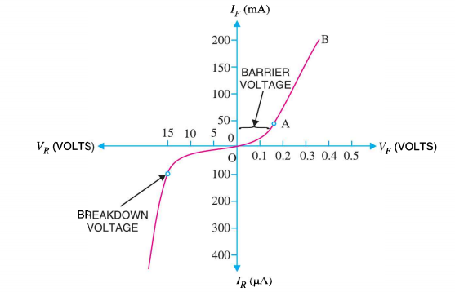
The characteristics can be explained under three cases such as:
Zero bias
Forward bias
Reverse bias
Case-1: Zero Bias
In zero bias condition, no external voltage is applied to the pn junction i.e the circuit is open at K.
Hence, the potential barrier at the junction does not permit current flow.
Therefore, the circuit current is zero at V=0 V, as indicated by point O in figure below.
Fig.2: V-I Characteristics of p-n Junction

Slide 16
Case-2 : Forward Bias
In forward biased condition , p-type of the pn junction is connected to the positive terminal and n-type is connected to the negative terminal of the external voltage.
Case-3 : Reverse Bias
In reverse bias condition , the p-type of the pn junction is connected to the negative terminal and n-type is connected to the positive terminal of the external voltage.

Slide 17
17. What is Transition & diffusion capacitance?
Transition capacitance
The amount of capacitance changed with increase in voltage is called transition capacitance. The transition capacitance is also known as depletion region capacitance, junction capacitance or barrier capacitance. Transition capacitance is denoted as C_{T}.
The change of capacitance at the depletion region can be defined as the change in electric charge per change in voltage.
CT = dQ / dV
Where,
CT = Transition capacitance
dQ = Change in electric charge
dV = Change in voltage
Diffusion capacitance (C_{D})
Diffusion capacitance occurs in a forward biased p-n junction diode. Diffusion capacitance is also sometimes referred as storage capacitance. It is denoted as C_{D}.
In a forward biased diode, diffusion capacitance is much larger than the transition capacitance. Hence, diffusion capacitance is considered in forward biased diode.

Slide 18
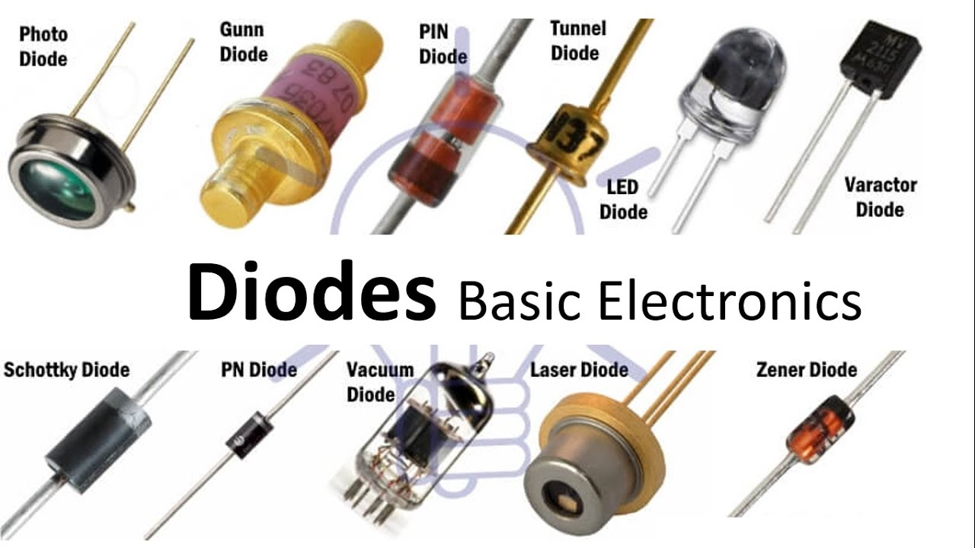
Applications of diode

Slide 19
18. What are the Applications of Diode?
Rectifying a voltage: turning AC into DC voltages.
Drawing signals from a supply.
Controlling the size of a signal.
Mixing (multiplexing) signals.
As freewheeling of the inductive energy.

Slide 20
19. What is rectifier?
An electrical device which converts an alternating current into a direct one by allowing a current to flow through it in one direction only.
20. What Is a Filter?
A filter is a circuit capable of passing (or amplifying) certain frequencies while attenuating other frequencies.
21. What is the advantage of voltage doubler?
It eliminates the use of a high voltage transformer. As it changes a low voltage to high at a low rate.
22. How do you make a voltage Tripler?
The voltage Tripler can be obtained by adding one more diode-capacitor stage to the half-wave voltage doubler circuit.

Slide 21
23. Main Difference Between Clipper & Clamper.
A clipper is used for limiting the voltage of the AC signal while the Clamper is used for multiplying the voltage of an AC signal. A clipper changes the shape of the signal while the clamper does not affect the shape of the waveform.
24. What is a Zener diode?
A Zener diode is a silicon semiconductor device that permits current to flow in either a forward or reverse direction.
25. What is a Light-emitting diode?
A light-emitting diode is a semiconductor device that emits light when current flows through it.
26. What is the Working principle of photodiode?
It Converts light into current.

Slide 22
27. What is the function of the varactor diode?
The function of the varactor diode is to store charges, so it is always operated in reverse bias conditions.
28. Where are photo resistors used?
Photo resistors are most often used as light sensors.
29 why crystal diodes are used for?
Crystal Diodes are mostly used for rectification (alternative current to pulsating DC).
30. What is a solar cell?
A solar cell, or photovoltaic cell, is an electronic device that converts the energy of light directly into electricity by the photovoltaic effect.

Slide 23
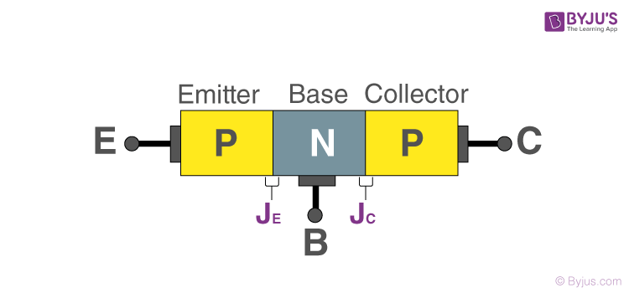
Bipolar Junction transistor

Slide 24
31. What is the working of NPN and PNP transistors?
In an NPN transistor, a positive voltage is given to the collector terminal to produce a current flow from the collector to the emitter.
In a PNP transistor, a positive voltage is given to the emitter terminal to produce current flow from the emitter to the collector.
32. What are the v-i characteristics of a transistor?
There are two types of characteristics.
Input characteristics: The Input characteristics describe any changes that occur in the Input Current because of the variation of the Input Voltage by keeping the Output Voltage constant.
Output characteristics: The output characteristics describe any changes that occur in the output Current because of the variation of the output Voltage by keeping the input current constant.

Slide 25
33. What is the configuration of a transistor amplifier?
We usually employ CE configuration for transistors as amplifiers because it provides large values of current gain, voltage gain and power gain. Moreover, there is a phase-shift of 180 degrees between input and output.
34. What is cut-off frequency?
The cutoff frequency determines where the signal is cut off.
35. What is Saturation region?
This is the region in which the transistor tends to behave as a closed switch.
36. Define load line analysis?
The load line analysis of the transistor means for the given value of collector-emitter voltage we find the value of collector current.

Slide 26
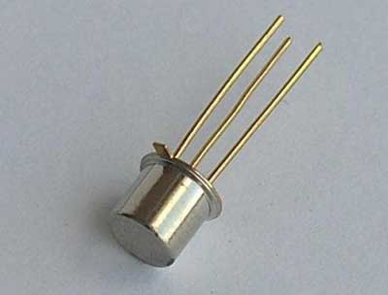
Field Effect Transistor

Slide 27
37. What is field effect transistor?
A Field Effect Transistor (FET) is a three-terminal Active semiconductor device, where the output current is controlled by an electric field generated by the input voltage.
38. What is JFET and its working?
JFET or Junction Field Effect Transistor is one of the simplest types of field-effect transistor. JFETs are voltage-controlled devices. In JFET, the current flow is due to the majority of charge carriers.
39. What are MOSFETs used in?
Their primary use is to control conductivity, or how much electricity can flow, between its source.

Slide 28
40. What are the various types of biasing of JFET?
These three are widely used:
a) Fixed DC Biasing Technique.
b) Self-Biasing Technique. &
c) Potential Divider Biasing.
41. What are the types of biasing in MOSFET?
a) Voltage Divider Bias
b) Drain Feedback Bias.

Slide 29
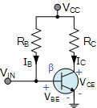
Transistor Biasing

Slide 30
42. What do you understand by transistor biasing? What is its need?
The proper flow of zero signal collector current and the maintenance of proper collector-emitter voltage during the passage of signal is known as transistor biasing. The need for biasing is to establish a DC operating point for the transistor so that it can properly amplify signals applied to its input.
43. Methods of Transistor Biasing.
Base resistor method
Emitter bias method
Biasing with a collector-feedback resistor
Voltage-divider bias

Slide 31
i) Base resistor method: A resistor is placed between the base and the positive power supply to provide a constant current to the base of the transistor.
ii) Emitter bias method: A resistor is placed between the emitter and the negative power supply to provide a constant current to the emitter of the transistor.
iii) Collector-feedback resistor method: A resistor is placed between the collector and the positive power supply to provide feedback to the base of the transistor, which helps to stabilize its operating point.
iv) Voltage-divider bias: Two resistors are placed in series between the positive power supply and ground, with the base of the transistor connected to the junction of the two resistors. This creates a voltage divider that sets the base voltage of the transistor.

Slide 32
44. The essentials of a biasing circuit are?
DC Power Supply: A DC power supply is required to provide the operating voltage to the transistor.
Resistors: Resistors are used to set the DC operating point of the transistor and to establish the required DC bias voltage.
Capacitors: Capacitors are used to remove any AC signals present on the power supply, which helps to prevent these signals from affecting the transistor's operation.
Transistor: A bipolar junction transistor (BJT) or a field-effect transistor (FET) is used as the active device in the circuit.

Slide 33
45. Why are transistor amplifiers always operated above the knee voltage region ?
Transistor amplifiers are usually operated above the knee voltage region because in this region, the transistor behaves as a linear device, meaning that the output current is proportional to the input current. This allows the transistor to amplify small variations in the input signal. In contrast, if the transistor is operated in the saturation region (below the knee voltage), the output current becomes largely independent of the input current, causing the transistor to act as a switch rather than an amplifier. To achieve the desired amplification of the input signal, transistor amplifiers are therefore typically operated above the knee voltage region.

Slide 34
Thank You

